Slide 1
Advance Augmented Reality Battle-system (AARB)
CS 337 Software Design
Group 4
Prepared By:
Namba, Kazuya
Liang, Tony
Lee, Hsu Peng
Hsu, Michael

Slide 2
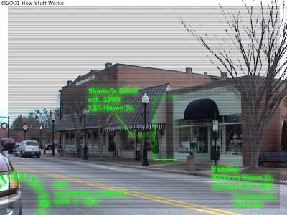
Brief Overview
A completely cloud-based Application
Similar to Mainframe
Provides exciting augmented reality experience
Source:http://www.uwplatt.edu/web/presentations/PennState/ar/pix/augmented-reality-hud.jpg.

Slide 3
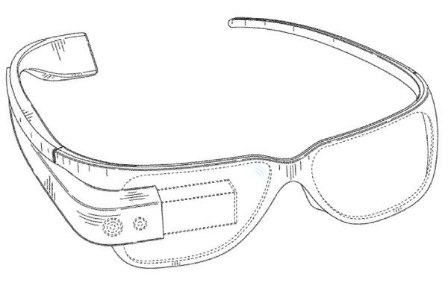

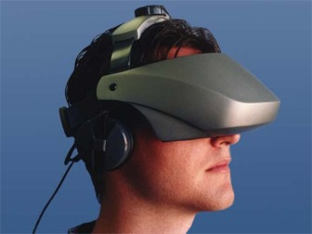
Hardware:
User End: Project Glass
-augmented reality head-mounted display (HMD)
HMD in the past:
Source:http://www.ubergizmo.com/wp-content/uploads/2012/05/project-glass-patent.jpg

Slide 4
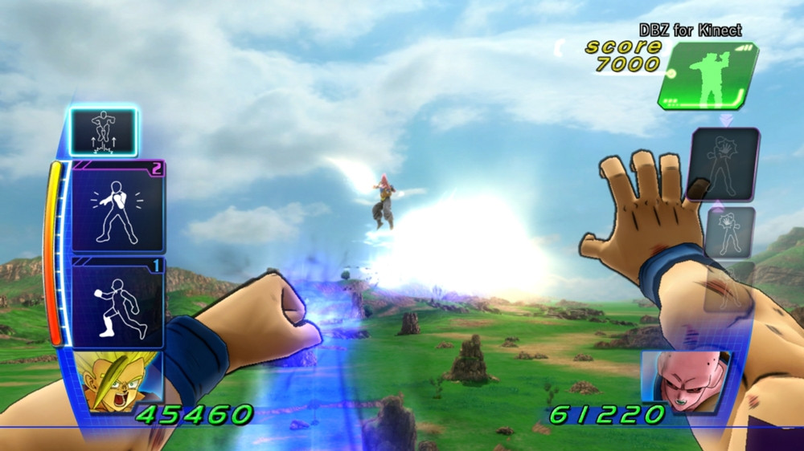
Inspiration
Dragon Ball for Kinect
Source:http://123kinect.com//wp-content/gallery/dragonball-z-kinect/dragon-ball-z-kinect_5_.jpg

Slide 5
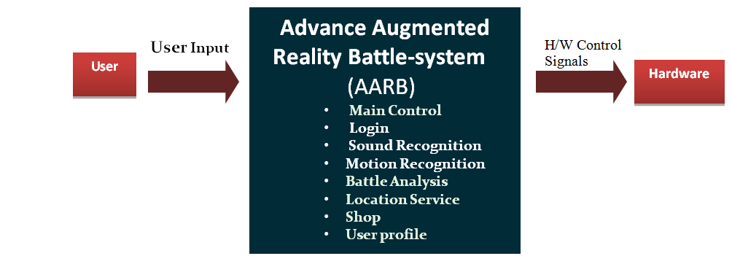
Level 0 DFD

Slide 6
Level 1 DFD

Slide 7
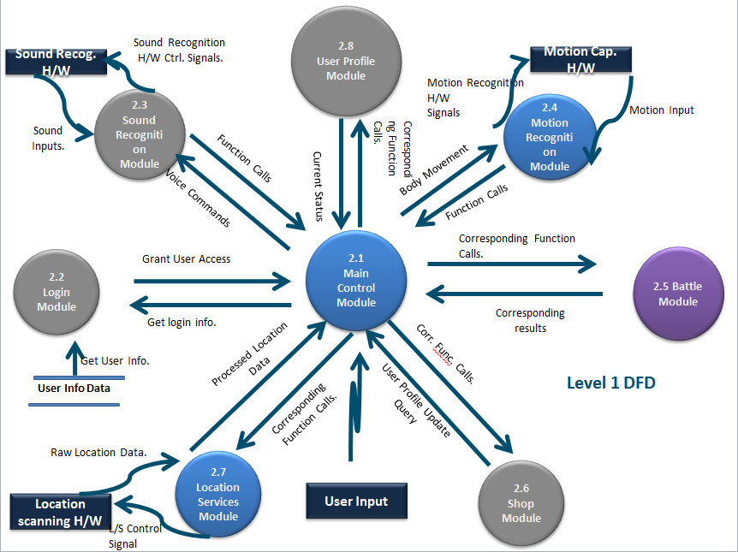

Slide 8
2.1 Main Control Module

Slide 10
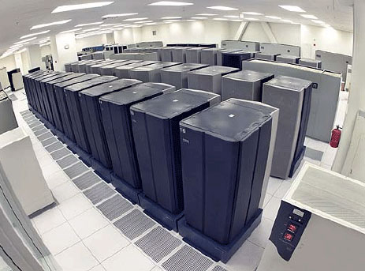
2.1 Main Control Module
Located on the server.
Instantiates a graphical user interface when user logs in to the server.
Responsible for intercommunication between all modules.
Source: http://farm3.static.flickr.com/2369/2084311380_0906fd827d_o.jpg

Slide 11
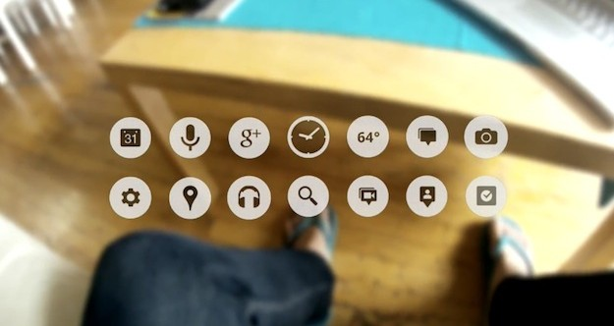
Submodules:
User Interface Submodule:
Instantiated every time the user connects
source:http://www.techedon.com/wp-content/themes/striking/cache/images/Google_Project_Glass_Video-625x332.jpg

Slide 12
Requirements:
Requirement No. | Requirement Description
 | User Interface Submodule(UIS)
3.1.1 | UIS shall be a GUI with scrolling menus.
3.1.2 | UIS shall be instantiated every time the user launches the game
3.1.3 | UIS shall take user input using the Data Input Controller Submodule.
3.1.4 | UIS shall display any necessary error, or other messages to the user.
3.1.5 | UIS shall display user controllable options.

Slide 13
Submodules Conti.
Data Input Controller Submodule:
Controls GUI display mode and input
methods.
Determine State of User: IB/NIB
switch user interface
Control Input method

Slide 14
Submodules Conti.
Information Bus Submodule:
Oversees and Controls all information and commands between all modules
Commands
Information
Commands
*this is a bus

Slide 15
2.8 User Profile Module

Slide 17
2.8 User Profile Module
updates user assets upon store transactions
increments user level when enough experience is gained from battle or training
increments user skill levels when skills are purchased in shop or upgraded
recalculates user currency depending on user spending and earnings
confirms item pickup and item placement in inventory
displays user location using LSM
shows user’s stats
handles user profile customization

Slide 18

List of submodules:
-User Assets Submodule
-User Experience Submodule
-User Skills Submodule
-User Items Submodule
-User Location Submodule
-User Statistics Submodule

Slide 19
User Assets Submodule
Requirements Related to Design Module 2.8.1: User Assets
Requirement No. | Requirement Description
3.8.1 | UAS shall process all user transactions with the SM to the User Profile Module.
3.8.1.1 | UAS shall update the UPM if the transaction was successful.
3.8.1.2 | UAS shall cancel the transaction if errors occurred.
3.8.1.3 | UAS shall not let the transaction go through if user does not have sufficient funds.
3.8.1.4 | UAS shall subtract the user’s funds when the user bought an asset.
3.8.1.5 | UAS shall add funds to the user when the user sold their asset(s) to the store.
3.8.1.6 | UAS shall transfer the correct asset to the user when the user bought the asset(s).
3.8.1.7 | UAS shall take the correct asset from the user when the user sold the asset(s).

Slide 20
User Experience Submodule
Requirements Related to Design Module 2.8.2: User Experience
3.8.2 | UES shall process all experiences given to the user to the User Profile Module.
3.8.2.1 | UES shall have every new user’s experience start at zero.
3.8.2.2 | UES shall calculate the user’s experience required to advance to the next level.
3.8.2.3 | UES shall add experience to the user when the user is rewarded with experience from battle which is calculated from the BCS.
3.8.2.4 | UES shall add experience to the user when the user does any physical training or exercise.
3.8.2.5 | UES shall increment the user’s level when the required experience is met.
3.8.2.6 | UES shall not ever take away the user’s experience under any circumstances.
3.8.2.7 | UES shall not reset the user’s experience back to zero every time the user advanced a level.

Slide 21
User Skills Submodule
Requirements Related to Design Module 2.8.3: User Skills
3.8.3 | USS shall process all user skill related information to the User Profile Module.
3.8.3.1 | USS shall already provide the user’s basic skills in a default level.
3.8.3.2 | USS shall have three types of skills.
3.8.3.2.1 | USS shall have physical skills.
3.8.3.2.1.1 | USS shall drain the user’s endurance or stamina when using physical skills.
3.8.3.2.2 | USS shall have active skills.
3.8.3.2.2.1 | USS shall drain the user’s mana when using active skills.
3.8.3.2.3 | USS shall have passive skills.
3.8.3.2.3.1 | USS shall not drain anything from the user when using passive skills.
3.8.3.3 | USS shall unlock new skills for the user if he or she bought them from the store.

Slide 22
User Items Submodule
Requirements Related to Design Module 2.8.4: User Items
3.8.4 | UITS shall process all user interactions with items to the User Profile Module.
3.8.4.1 | UITS shall set the same maximum number of inventory slots that every user will have.
3.8.4.2 | UITS shall show name labels next to every item the user has.
3.8.4.3 | UITS shall show a brief description of every item the user has.
3.8.4.4 | UITS shall add the item to the user’s inventory if the user picked it up.
3.8.4.5 | UITS shall add the correct asset(s) to the user’s inventory if the user bought anything from the store.
3.8.4.6 | UITS shall remove the asset(s) from the user’s inventory if the user sold any asset(s) to the store.
3.8.4.7 | UITS shall allow all equipment to be equipable.
3.8.4.7.1 | UITS shall categorize all equipment the user has to the appropriate body part using the CSM.

Slide 23
User Location Submodule
Requirements Related to Design Module 2.8.5: User Location
3.8.5 | ULS shall process the user’s current location, which is received from the LSM, to the User Profile Module.
3.8.5.1 | ULS shall record the user’s exact location.
3.8.5.2 | ULS shall translate the user’s exact location to the full street address.
3.8.5.3 | ULS shall display the full street address of where the user is currently at.
3.8.5.4 | ULS shall display a map view with a character icon at the user’s current location.
3.8.5.4.1 | ULS shall display the direction the user is currently facing.

Slide 24
User Statistics Submodule
Requirements Related to Design Module 2.8.6: User Statistics
3.8.6 | USTS shall process the user’s statistics to the User Profile Module.
3.8.6.1 | USTS shall display the user’s current health.
3.8.6.2 | USTS shall display the user’s current mana.
3.8.6.3 | USTS shall display the current equipment(s) the user is wearing.
3.8.6.3.1 | USTS shall change the user’s appearance when the user equips any of his or her equipment.
3.8.6.3.2 | USTS shall change the user’s appearance when the user unequips any of his or her equipment.
3.8.6.4 | USTS shall display the user’s endurance.
3.8.6.5 | USTS shall display the user’s stamina.
3.8.6.6 | USTS shall display the user’s immunities.
3.8.6.7 | USTS shall display the user’s weaknesses.
3.8.6.8 | USTS shall display the user’s strengths.

Slide 25
2.7 Location Service Module

Slide 27
2.7 Location Service Module(LSM)
LSM controls GPS H/W.
Geographic Scanning Module (GSS)
generates 2D/3D battlefield map.
Data will be stored in BDS(Battle Data Submodule).
Location Tracking Submodule (LTS)
LTS continuously tracks user location.

Slide 28
2.5 Battle Module

Slide 30
2.5 Battle Control Module(BCM)
Battle Interface Submodule(BIS)
display user interface
generate special effects
Battle Data Submodule(BDS)
store current data
Matchmaking Submodule(MMS)
setup new battle, show result
Battle Calculation Submodule(BCS)
do calculation and control system during the battle

Slide 31
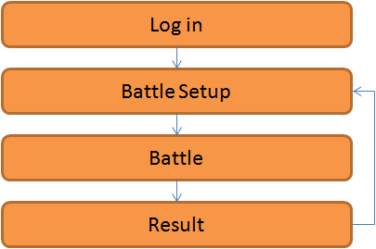
Submodules:
Battle Calculation Module(BCM)
Battle Calculation Module is to control the system after user logged in.

Slide 32
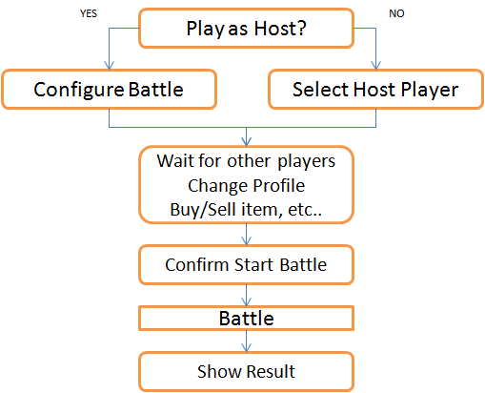
Battle Interface Submodule(BIS)
Display User Interface

Slide 33
Battle Interface Submodule(BIS)
During Battle
Show current battle information
Display time, location, player status
Popup messages, errors
Enable users to access battle information
User Profile
Game Setting
Help
Exit
Generate special effects

Slide 34
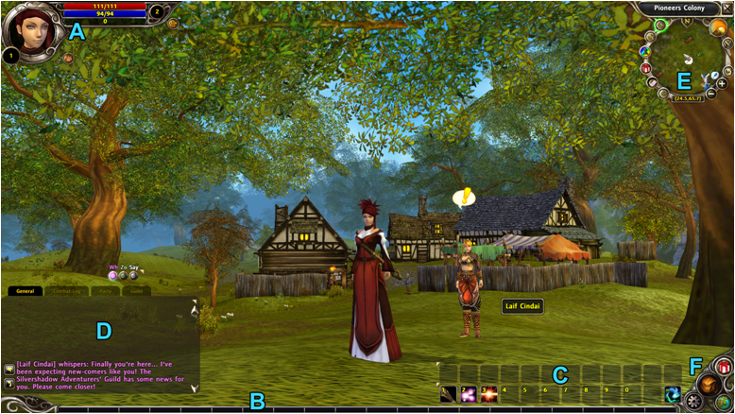

Slide 36
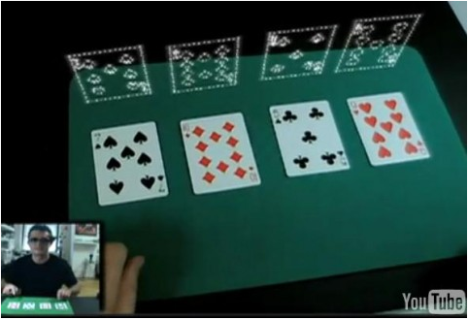
Special Effects

Slide 37
Battle Data Submodule(BDS)
Store battle environment data
time
location
network
Store player data (all players in the battle)
status
skill
equipment
money
location

Slide 38
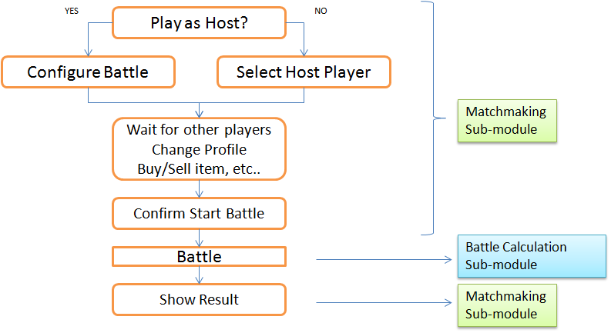
Matchmaking Submodule(MMS)
Battle Calculation Submodule(BCS)
These two submodules control the system

Slide 39
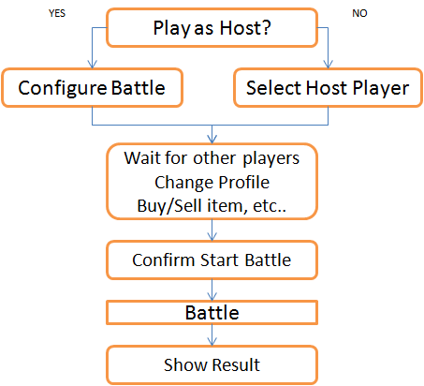
Matchmaking Submodule(MMS)
Choose if play as Host
Host setups battle environment
Time Limit
# of Players
Battlefield
Non-Host Player choose Host
List all Host players
View joined players
enable player to access
Shop Module
User Profile Module
confirm players to begin the battle
show results after each battle
Exp. earned
Item/skill earned
Score
enable player to exit the battle

Slide 40
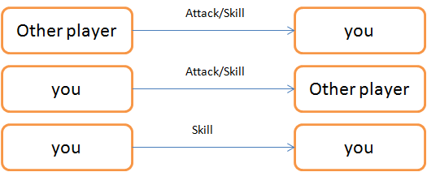
Battle Calculation Submodule(BCS)
Battle Calculation Submodule controls the battle part.
Calculation Patterns

Slide 41
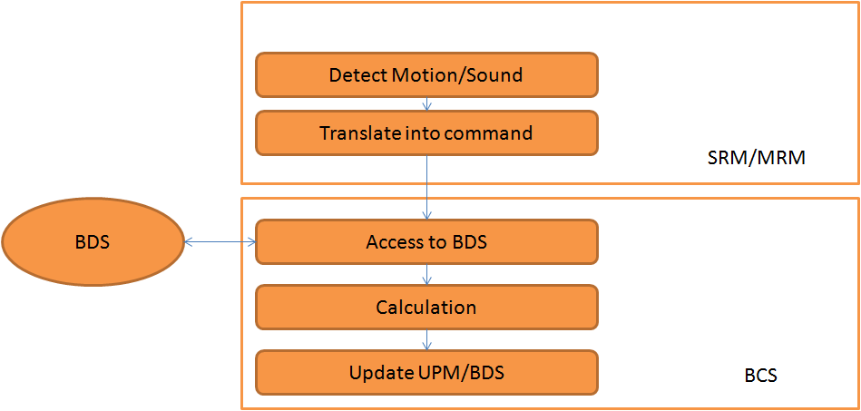

Slide 42
Battle Calculation Submodule(BCS)
Input must comes from Sound/Motion Recognition Modules
For any case, BCS access to Battle Data Submodule to obtain data of all players involved
BCS may access the skill database as necessary
After calculation, BCS returns the result and stores it into User Profile Module
Generate warning as player gets too close to edge of Battlefield
Generate message as battle reaches close to time limit
Generate warning if network is unavailable

Slide 43
2.6 Shop Module

Slide 45

Shop Module (SM)
Search Categories Submodule (SCS)
Providing searching bar function.
Sorting items and skills by grade.
Matching Categories like weapons , armors, potions, fireball skills, frozenball skills, lighting ball skills.
Organizing all items and skills.

Slide 46
Calculation Item Submoduele (CIS)/Calculation Skills Submodule (CSS)
Doing calculation when user is purchasing items or skills.
Displaying full price of items and skills.
Adding funds to Shop Module (SM)
Subtracting funds to Shop Module (SM)

Slide 47

User Transaction Submodule (UTS)
Getting golds System
100 golds $1,
250 golds $2
400 golds $3
600 golds $4
900 golds $5
Providing several puchase methods
paycard method (Visa, Master Card, American Express)
paypal method
mobile payment method
prepaid card method
paysafecard method

Slide 48
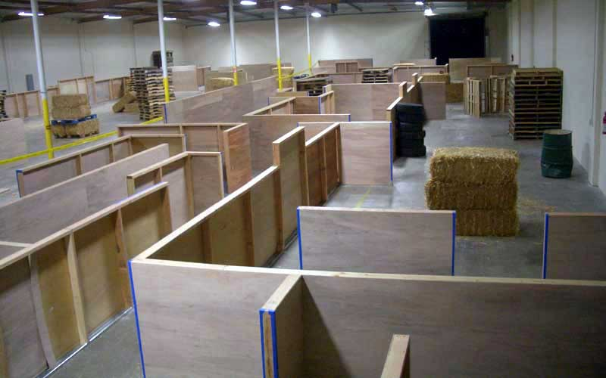
Future Possibilities:
-Linking User profile module with Google accounts
-Users can upload their own battle areas
-Training mode: Working out in real life translates to experience in game
-Work with airsoft facilities to create dedicated battle areas
Source:http://www.planetairsoft.net/archives/Pictures/05-2006-NEWS/APG-RightAirsoftField.jpg

